Slide 1

CAR PRICE PREDICTION
PRESENTED BY,
GROUP 8
SRINIJA BEESAGOUNI
PUNIT KUMAR
SIDDU BELLAM
KEERTHI KAMTAM

Slide 2
AGENDA
Objective
EDA (Exploratory Data Analysis)
Dataset overview
Variables Correlation
3. Model Building
Model Selection
Hypothesis test on MLR model
4. Outlier Diagnostics
Residual analysis
Model assumptions (test for Homoscedasticity, Polynomial regression)
5. Multicollinearity Diagnostics
Effects of Multicollinearity
Handle multicollinearity
6. Final model
Model Validation & Predictions on train , test dataset.
7. Key findings & Recommendations
8. Conclusion
9. References

Slide 3
objective
If we look at car companies, we see that they set different prices of cars based on a few set of factors .
If a new company is planning to invest in manufacturing cars, it would be really useful for the company to understand some of the factors that affect the prices of the car respectively. Not only new company, if any customer planning to purchase car they must predict price based on car features and decide on purchasing as per market trend.
This project aims to predict car prices based on various car features . A model will help us understand the exact relationship between different variables and how these variables are used to predict the result.

Slide 4
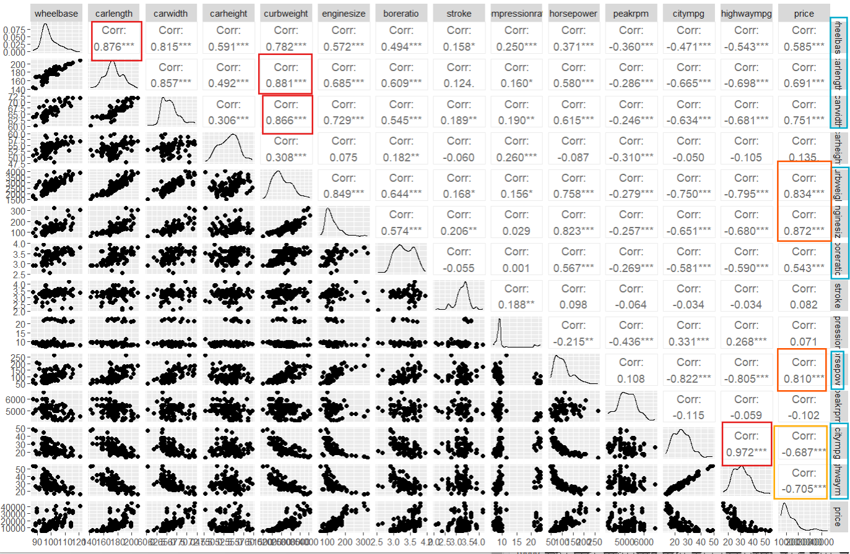
EDA
After performing Exploratory data analysis final dataset has 25 variables(11 qualitative, 14 quantitative) , 201 observations. (refer section 2.1 for dataset overview)
Scatter plot of numerical variables

Slide 5
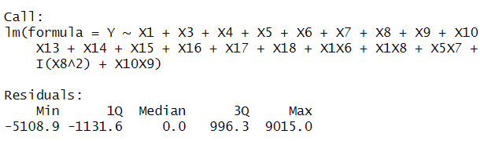

Model building
Coefficients of full model is verified. (refer section3.1)
Analysis on variance table is performed to check interaction terms significance for model building.
Stepwise selections methods are used to select subset model , final variables (20) based on best forward model with low AIC value are X5(enginesize) , X17(cylindernum) , X16(enginetype) , X5X7 , X4(curbweight) , X13 (carbody), X18(fuelsystem) ,X14(drivewheel) , X7(horsepower) ,X3(carwidth) , X1X8 , X10X9 , X15(enginelocation) , X1X6 ,I(X8^2) , X8 (citympg), X1(wheelbase) , X6(boreratio), X9(highwaympg), X10(fueltype) out of 29 variables.
Train & Validation split for model validation with 75%, 25%, Validation model has better improvement than Train model. (refer section 3.3)

Slide 6
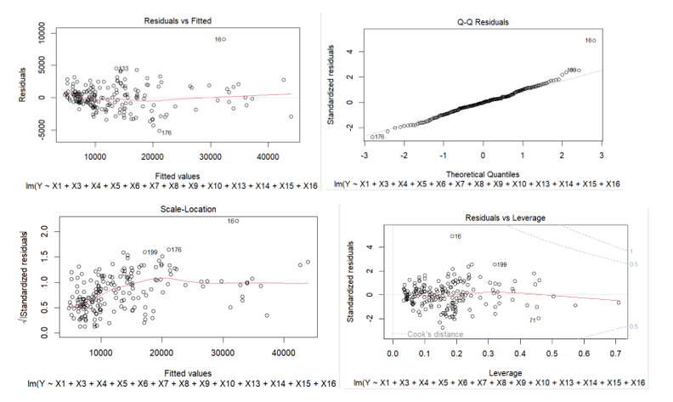
OUTLIER DIAGNOSTICS
Residual plots
Cooks distance threshold = 0.02, 20 influential cases found more than threshold.(refer section 4.1)
Heteroscedasticity?
Polynomial regression model?

Slide 7
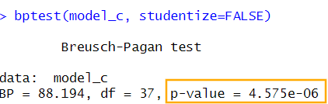
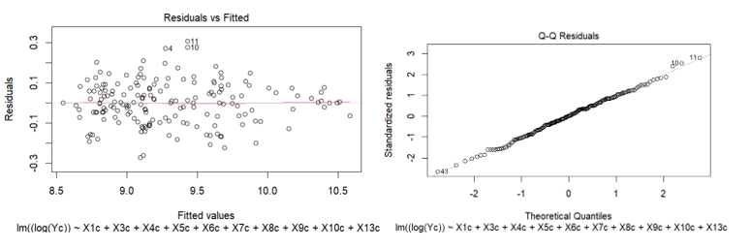
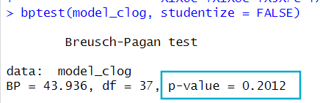
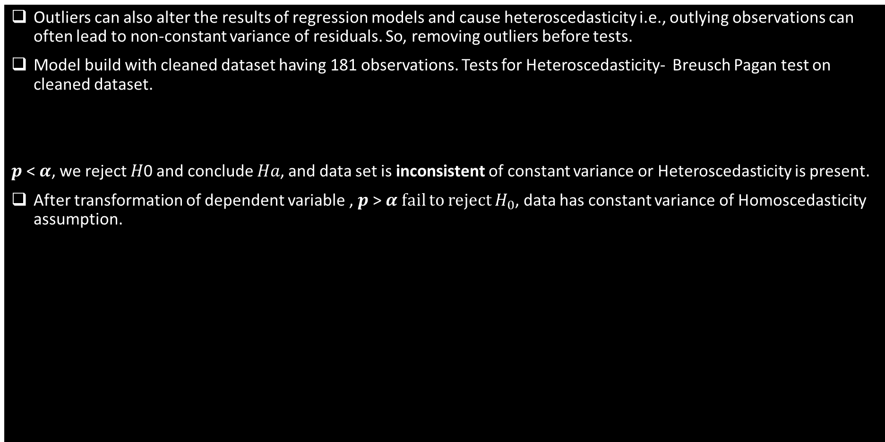
OUTLIER DIAGNOSTICS(Contd..)
Outliers can also alter the results of regression models and cause heteroscedasticity i.e., outlying observations can often lead to non-constant variance of residuals. So, removing outliers before tests.
Model build with cleaned dataset having 181 observations. Tests for Heteroscedasticity- Breusch Pagan test on cleaned dataset.
𝒑 < 𝜶, we reject 𝐻0 and conclude 𝐻𝑎, and data set is inconsistent of constant variance or Heteroscedasticity is present.
After transformation of dependent variable , 𝒑 > 𝜶 fail to reject $H_{0}$, data has constant variance of Homoscedasticity assumption.

Slide 8
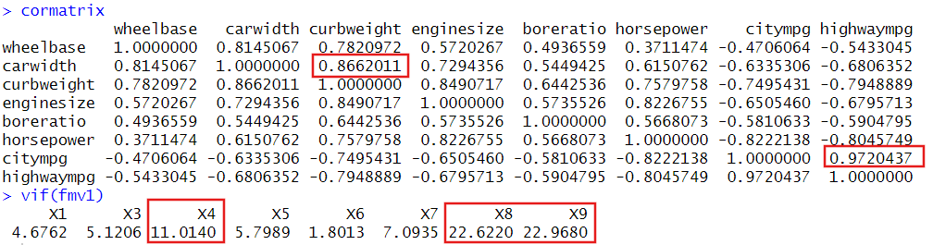
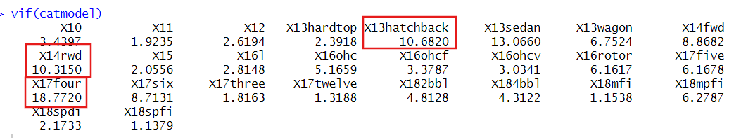
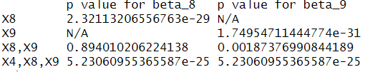
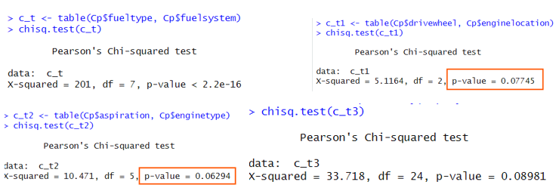
MULTICOLLINEARITY DIAGNOSTICS
Correlation matrix of numerical variables & VIF of independent variables (Curbweight, Citympg, Highwaympg)
Effects of multicollinearity on t-test to check significance of highly correlated variables.
Handling Multicollinearity- Performed Ridge regression on cleaned dataset with transformation and all coefficients of ridge model is near to 0.
Predictions on Validation set with standardized predictors R-square = 0.938.

Slide 9
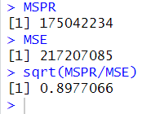
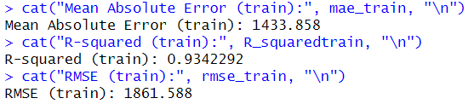
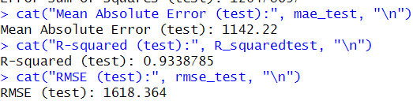
Final model & validation
Mean square prediction error on Validation test of ridge model.
The ratio is 0.89, which is less than 1. This indicates that our model performs slightly better on the validation set than on the training set, suggesting good generalization and a low risk of overfitting.
Used Ridge regression model on both Train & Test datasets, below are the key metrics.

Slide 10
Key findings
Significant Predictors
Variables like Wheelbase , Carwidth, Curbweight, enginesize, horsepower, highwaympg, drivewheel, enginelocation, enginetype, cylindernumber, drivewheel, enginelocation, wheelbase with boreratio, wheelbase with citympg, enginesize with horsepower are significantly influence car prices prediction.
Outliers
20 influential cases were identified with Cook’s distance above the threshold of 0.02 were removed. Heteroscedasticity is handled so the residuals have constant variance across all values of the independent variable(s).
Multicollinearity
Variables such as curbweight, citympg and highwaympg exhibited multicollinearity, as detected through high VIF values.
Ridge regression effectively mitigated multicollinearity and improved model stability.
Model Validation
A train-test split (75% training, 25% testing) confirmed the model’s generalizability. Prediction on the validation dataset showed improvements over the training dataset.
Around 93% of the variability observed in the target variables is explained by the regression model.

Slide 11
recommendations
Feature Engineering
Since there is much collinearity observed in the variables , its better to consider some additional valuable variables for the predictions of car price.
Data Quality
Address influential outliers in future datasets through robust cleaning methods to prevent their impact on model performance.
Model Validation
Maintain the train-test split for future validation, ensuring predictive accuracy across diverse datasets.
Business Strategy
Utilize insights from the model to optimize car designs by prioritizing features that significantly influence pricing.
Target marketing efforts toward segments with the highest price impact (e.g., premium cars with high enginesize and horsepower ).

Slide 12
conclusion
The analysis highlights the key factors affecting car prices, with significant contributions from variables such as enginesize, horsepower, and curbweight. Addressing multicollinearity and incorporating interaction terms enhanced the model's predictive accuracy. By refining the regression model through feature selection and validation, we provide a reliable tool for predicting car prices. These insights are valuable for both manufacturers and consumers, aiding in strategic decision-making and aligning with market trends.

Slide 13
references
Applied linear regression models.—4th ed. / Michael H. Kutner, Christopher J. Nachtsheim, John Neter. p. cm.
Cook, R. D. (1977). Detection of influential observation in linear regression. Technometrics, 19(1), 15-18.
Goldfeld, Stephen M.; Quandt, Richard E. (1972) Nonlinear Methods in Econometrics, Amsterdam: North Holland Publishing Company, pp. 93–94. Referred to in: Gujarati, Damodar (1988) Basic Econometrics (2nd Edition), New York: McGraw-Hill,p. 329.
Berenguer-Rico , V., & Wilms, I. (2021). Heteroscedasticity testing after outlier removal. Econometric Reviews, 40(1), 51-85.
Raza, Muhammad & Ahmed, Mumtaz & Razzaque, Shahid & Hina, Hafsa. (2023). Testing for Heteroskedasticity in The Presence of Outliers. Journal of Education and Social Studies. 4. 313-329. 10.52223/jess.2023.4209.

Slide 14
THANK YOU

Slide 15
Section 2.1
Dataset contains 25 variables (11 qualitative, 14 quantitative) , 205 observations.
Symboling: A risk factor assigned to the car (-3 to +3), where higher values indicate more risky cars.
carName: Name of the car (brand and model).
fueltype: Type of fuel (e.g., 1- gas , 0-diesel). [X10]
aspiration: Type of aspiration (e.g., 1-standard , 0-turbocharged), Door number: Number of doors. (e.g., 0-two-door, 1-four-door). [X11]
carbody: Type of car body (e.g., sedan, hatchback). [X13]
drivewheel: Type of drive wheel (e.g., front-wheel drive). [X14]
enginelocation: Location of the engine. (e.g., 1-front, 0-rear). [X15]
wheelbase: The distance between the front and rear axles of the car, typically measured in inches or millimeters. [X1]
carlength, carwidth, carheight : Length, width, height of the car. [X2, X3]
curbweight: combines weight of the car [X4]
enginetype: Type of the engine (e.g., Turbo charged, Turbo engine, Buick, Internal combustion engine, Flat engine, V8 engine SBC , rotary) [X16]
cylindernumber: Number of cylinders. [X17]
enginesize: size of the engine in cubic cm. [X5]
fuelsystem: system that delivers the proper amount of fuel to the engine. [X18]
boreratio: determines engine’s power & torque characteristics. [X6]
stroke: movement of piston in the cylinder.
compressionratio: minimum to maximum cylinder volume.
horsepower: measurement of engine power. [X7]
peakrpm: speak of the car in revolution per minute.
citympg: mileage in cities [X8]
highwaympg: mileage on highway roads. [X9]
price: price of the car. [Y]

Slide 16
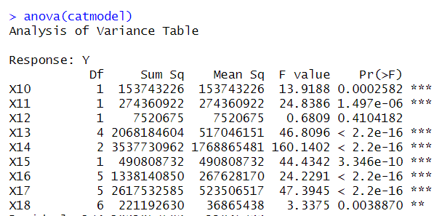
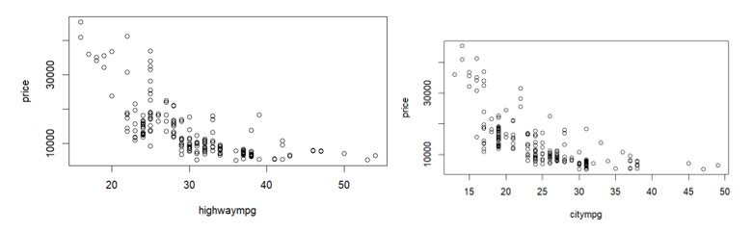
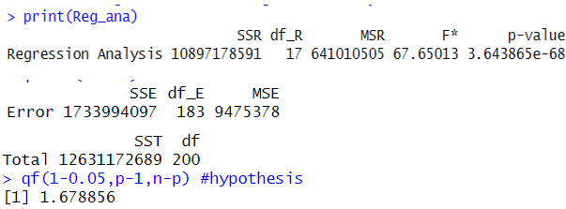

Section 2.2
Category variable correlation Significant category variables
Hypothesis test
Is Polynomial regression required?
F* = 67.6503, R2 = 0.86272, R2a = 0.849 , r= 0.92 ,
F*>1.67 , we reject $H_{0}$ and conclude $H_{a}$.

Slide 17
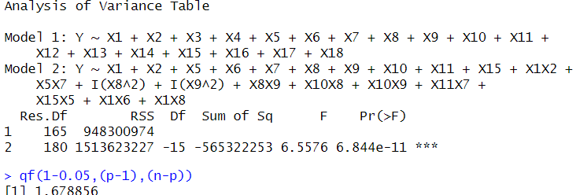

Section 3.1& 3.2
Using non linear variables(X8-citympg, X9-highwaympg) as polynomial terms in regression model, if they are not significant through stepwise model will be removed.
Hypothesis test on Interaction & additictive model - F*> F (6.5576 > 1.678) , We reject the null hypothesis and conclude 𝐻a . This means all interaction terms are not zero for 𝛼 = 0.05.
Best 2 models created by leaps & bounds with least BICp , Cp and large $R^{2}$.

Slide 18
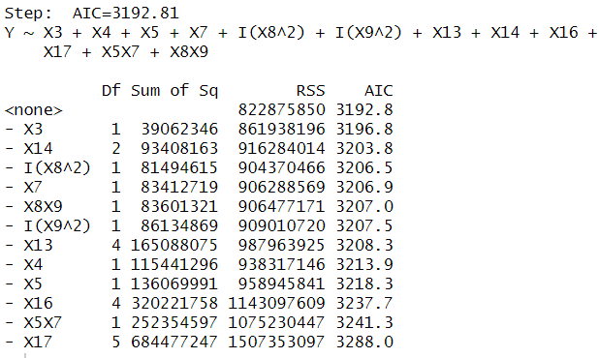
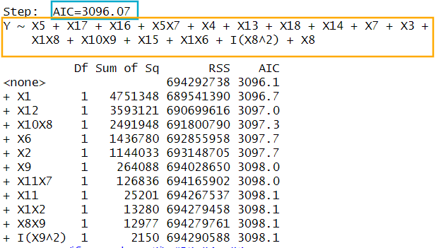


Section 3.1& 3.2
Backward model Forward model
The best model is E($Y_{i}$) = $β_{0}$ + $β_{1}x_{i5}$ + $β_{1}x_{i17}$+$β_{2}x_{i16}$+$β_{3}x_{i5}X_{i7}$+$β_{4}x_{i4}$ + $β_{5}x_{i13}$+$β_{6}x_{i18}$+$β_{7}x_{i14}$+$β_{8}x_{i7}$+$β_{9}x_{i3}$+ $β_{10}x_{i1}X_{i8}$+ $β_{11}x_{i10}X_{i9}$+$β_{12}x_{i15}$+$β_{13}x_{i1}X_{i6}$+$β_{14}x_{i8}^{2}$+$β_{15}x_{i8}$
Hypothesis test- Model is significant with F-test

Slide 19
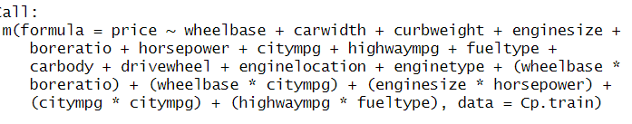


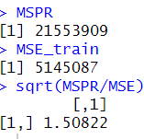
SECTION 3.3 Model Validation(gen model)
Train & Validation split for model validation with 75%, 25% performed with variables finalised with regression procedure.

Slide 20
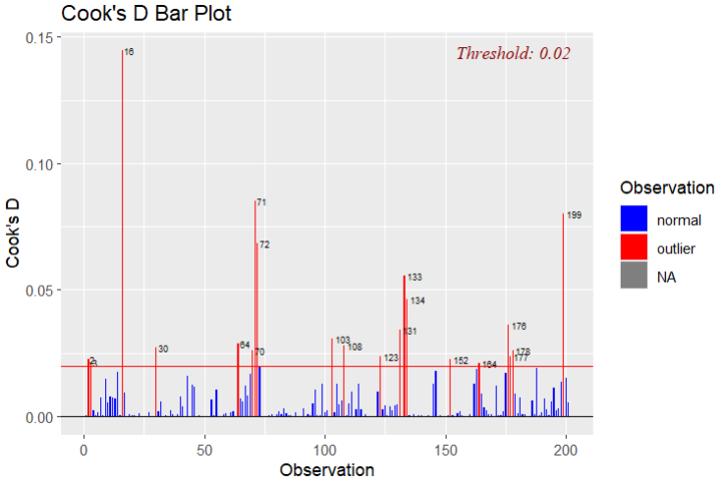
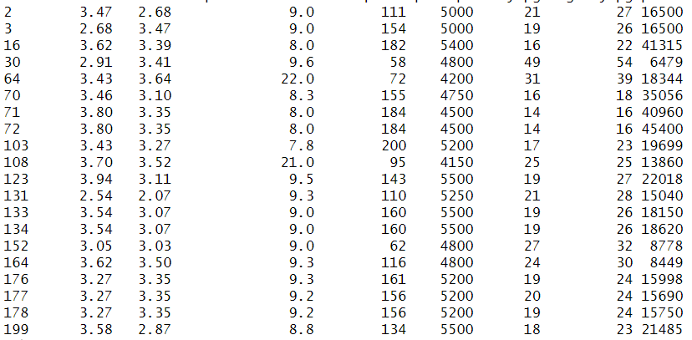


Section 4.1
No Y observations, several X observations
Cooks distance Influential cases
New model with cleaned dataset

Slide 21
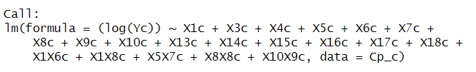

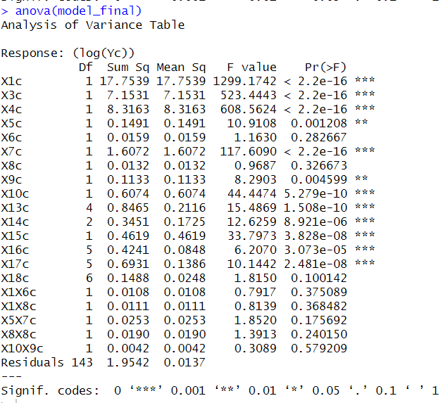
Section 4.2
Cleaned dataset model

Slide 22
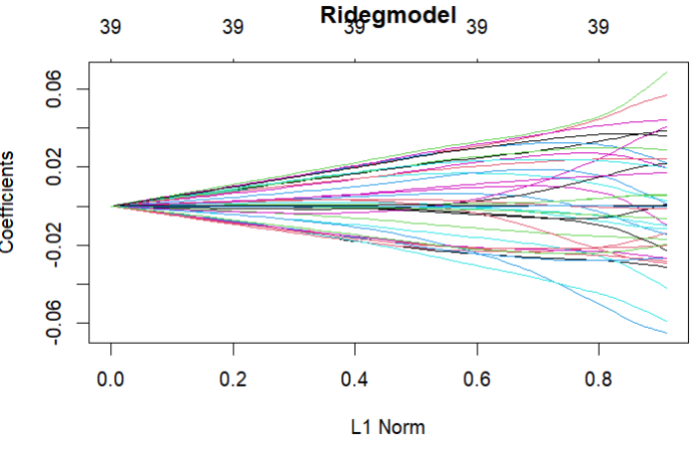
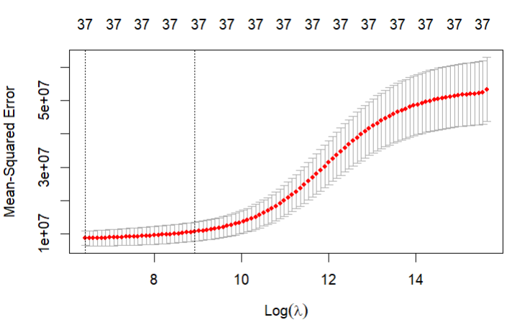
Section 5.1
Correlation matrix
Ridge model, cross validation ridge
As we can see from the graph above, for low values of Lambda, the Mean Squared Error is quite low. On the contrary, as the value of Lambda increases, the Mean Squared Error also increases

Slide 23
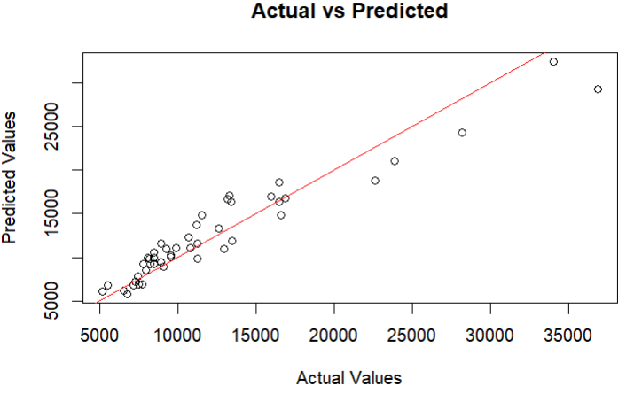
Section 5.2
Actual Vs Predicted plot on prediction test.

